Slide 1
BUSINESS & ANALYTICS CASE STUDY
SkillStream Pro
Subscription Revenue Optimization
Jan 2024 - Feb 2026
SQL Analytics Project
Analysis Period
Data Points
Projected Impact
13 Months
614 Records
$120K+

Slide 2
EXECUTIVE OVERVIEW
Executive Summary
Core Business Problem
18% revenue per user decline despite 12% subscriber growth - a paradoxical situation demanding immediate data-driven intervention.
Total Revenue Impact Opportunity
$120K+
Key Analytical Finding
Annual Recovery Potential
80% churn probability after 30+ days of inactivity - early warning system enables proactive retention with 300% ROI.
$90K
$15K
Retention Campaign
Payment Recovery
Strategic Takeaway
$35K
$216K
Data-driven retention and acquisition optimization can reverse revenue decline within 90 days through targeted interventions.
Marketing Optimization
Onboarding Improvement
Implementation Timeline
90 Days
Quick Wins Identified

Slide 3
MARKET LANDSCAPE
Business Context & Industry Overview
SaaS/EdTech Industry
$1T
Digital Learning Platform Market
The global e-learning market is experiencing explosive growth, projected to reach $1 trillion by 2028 with a 20% compound annual growth rate. However, this rapid expansion brings intense competition with over 500 major platforms competing for market share.
Market Size by 2028
CAGR Growth
20%
Market Dynamics (2025-2028)
Major Platforms
500+
Rising CAC: Customer acquisition costs increasing 40% year-over-year due to platform saturation
Avg Subscriptions
12+
AI Competition: AI-powered platforms offering personalized learning at lower costs
Retention Priority: Retaining existing customers is 5x cheaper than acquiring new ones
Subscription Fatigue: Average consumer manages 12+ subscriptions; cancellation rates rising
Why Data-Driven Decisions Matter
Top-performing SaaS companies leverage analytics for 80% of strategic decisions. In this competitive landscape, understanding customer behavior patterns, churn predictors, and LTV drivers is not optional—it's essential for survival and growth.

Slide 4
COMPANY PROFILE
Company & Business Model Overview
SkillStream Pro
Subscription Pricing Tiers
B2C Digital Learning Platform
Basic
$15/mo
Founded
Headquarters
$150/year
2022
United States
50 courses, Mobile app, Email support
Active Subscribers
Course Library
Pro
$35/mo
~50,000
200+
$350/year
200 courses, Certificates, Download videos
Target Audience
Premium
$75/mo
Career-focused professionals aged 25-45 seeking technical skills and career advancement opportunities through professional certification programs.
$750/year
Unlimited courses, 1-on-1 mentoring, 24/7 support
Team
$100/mo
Competitive Advantages
5 seats
Admin dashboard, Team analytics, Priority support
Expert-curated content
Job market alignment
Mobile-first platform
Industry certifications
1-on-1 mentoring
Annual Billing Incentive
Annual subscriptions receive 2 months free (16.7% discount), encouraging long-term commitment and improving cash flow predictability while reducing churn.

Slide 5
CRITICAL CHALLENGE
Problem Statement: The Revenue-Growth Paradox
The Paradox
Root Cause Hypotheses
-18%
+12%
+
1
Adverse Selection
New subscribers choosing lower-tier plans (Basic vs Pro/Premium)
Revenue Per User
Subscriber Growth
2
Churn Concentration
Critical Issue: Revenue per user (RPU) has declined 18% in Q1 2026 despite subscriber count increasing 12%. This indicates systemic problems requiring immediate investigation.
High-value customers churning while low-value customers stay
3
Downgrade Trends
Existing users moving from premium tiers to basic plans
Board Meeting Urgency
4
Engagement Decline
Users not seeing value, leading to plan downgrades
The CFO needs data-backed answers before the Q2 2026 board presentation to explain the revenue decline, demonstrate corrective action plans, and provide revenue forecasts for H2 2026.
5
Acquisition Quality
Marketing channels bringing in low-LTV customers
Business Risk
Without intervention, continued RPU decline will negate subscriber growth benefits, leading to flat or declining total revenue and potential cash flow challenges.

Slide 6
STRATEGIC GOALS
Project Objectives
1
Identify Revenue Patterns
2
Reduce Churn Risk
Analysis Framework
Analyze subscription lifecycle stages and revenue distribution across user segments to understand where revenue concentration exists and where it is declining.
Detect early warning signals of subscription cancellations through engagement metrics, payment patterns, and usage behavior to enable proactive intervention.
Tier 1: Basic SQL
Foundation queries for baseline metrics
Tier 2: Intermediate
Window functions, CTEs, cohort analysis
3
4
Tier 3: Advanced
Optimize Pricing Strategy
Maximize Customer LTV
Predictive modeling, risk scoring
Evaluate tier performance, upgrade/downgrade patterns, and price elasticity to validate current pricing and recommend adjustments for revenue maximization.
Calculate LTV by acquisition channel, identify high-value customer characteristics, and allocate marketing spend to channels producing highest-return customers.
Expected Outcomes
5
Improve Retention Through Engagement
Data-backed answers for board meeting
Actionable retention strategies
Identify high-value user behaviors that correlate with long-term retention and build engagement benchmarks for onboarding optimization. Focus on activation metrics that predict 12-month retention.
Revenue recovery roadmap
Predictive alerting system

Slide 7
METHODOLOGY
Data & Analytical Approach
Dataset Overview
Analytical Methods
100
107
Cohort Analysis
Users
Subscriptions
Group users by signup period to track retention patterns over time and identify at-risk cohorts.
257
150
Segmentation
Transactions
Activity Records
Divide customers by behavior, value, and channel to understand different user groups and their needs.
Analysis Period
Date Range
13 Months
Jan 2024 - Feb 2026
Trend Analysis
Track revenue, engagement, and churn metrics over time to identify patterns and anomalies.
Data Quality Considerations
Predictive Modeling
Missing Values: 5% NULL in acquisition_channel (coded as 'Unknown')
Build churn risk scores using engagement, payment, and subscription data for early intervention.
Data Standardization: Country names normalized in queries
Edge Cases: Payment failures, suspended accounts handled
SQL Techniques Demonstrated
Window Functions
CTEs
Advanced JOINs
Statistical Functions

Slide 8
KEY INSIGHT #1
Churn Prediction Breakthrough
What is Happening
Churn Risk Score Model
Users with 30+ days of inactivity have an 80% probability of churning. This critical threshold provides a clear early warning signal for proactive intervention.
Inactivity Factor
40 pts max
Days since last activity × 0.67
Evidence & Metrics
Engagement Factor
30 pts max
Based on courses completed
15%
80%
Payment Factor
20 pts max
Current Churn Rate
Churn Probability
Failed transactions × 10
vs <5% benchmark
after 30 days inactive
Age Factor
10 pts max
Newer subscriptions = higher risk
Business Interpretation
Early intervention window exists. By triggering alerts at 14-day inactivity, we can engage users before they reach the critical 30-day threshold, significantly improving retention rates.
Expected Impact
$90K
Annual Revenue Saved
Through automated retention campaigns with 300% ROI

Slide 9
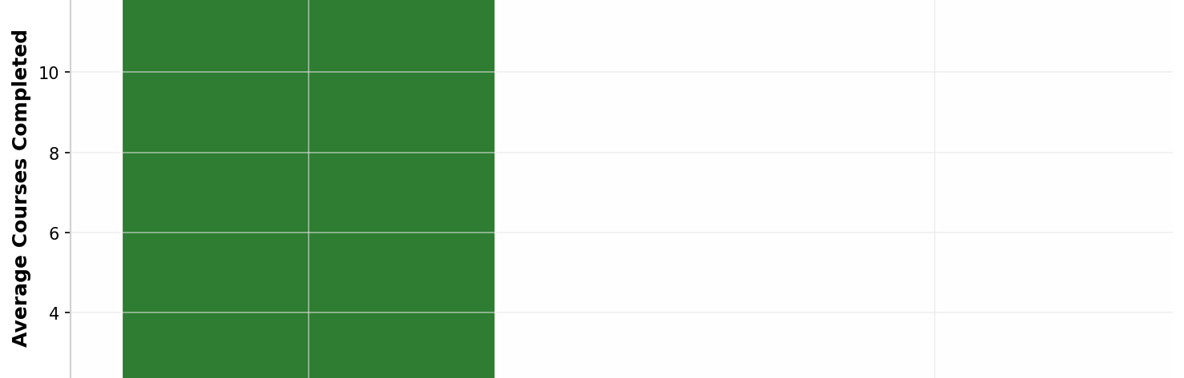
KEY INSIGHT #2
The 2-Course Activation Rule
What is Happening
Business Interpretation
Users completing 2+ courses in the first 7 days have 3x higher 12-month retention rates. This activation metric is the strongest predictor of long-term engagement.
Onboarding optimization is critical. The first week experience determines long-term retention. Users who experience early success (completing 2+ courses) are significantly more likely to remain engaged and become paying customers.
Activation Rate Targets
Engagement Comparison
Current Activation Rate
40%
Target Activation Rate
60%
Evidence
Expected Impact
$216K
12.3
0.0
Annual Revenue
Avg courses (Active)
Avg courses (Churned)
By increasing activation from 40% to 60%, we retain 100 additional users/month at $180 LTV

Slide 10
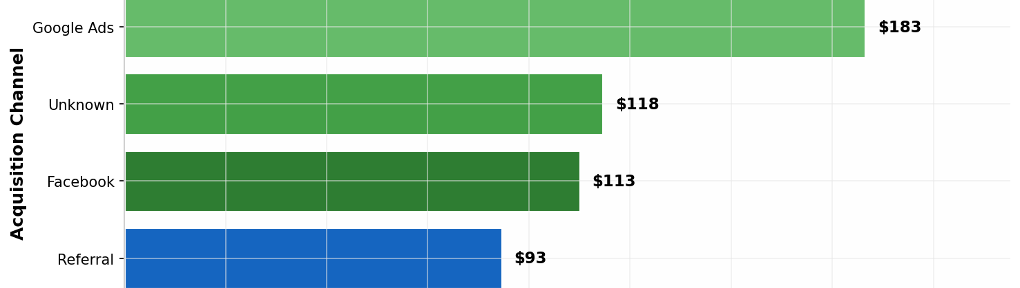
KEY INSIGHT #3
Acquisition Channel ROI Inequality
What is Happening
Business Interpretation
LinkedIn and Google Ads produce 2.5x higher revenue per user than Facebook and Organic channels. Marketing budget allocation is not optimized for LTV.
Significant marketing budget reallocation opportunity exists. Channels with higher RPU deserve increased ad spend, while low-performing channels need optimization or budget reduction.
Recommended Actions
Revenue Per User by Channel
1
Shift 30% Budget
From Facebook/Google to LinkedIn
2
Launch Referral Program
"Give $20, Get $20" incentive
3
Optimize Low Channels
A/B test creative and targeting
Channel Performance
LinkedIn
$189 RPU
Google Ads
$183 RPU
Facebook
$113 RPU
Organic
$73 RPU
Expected Impact
$35K
Additional Annual Revenue
Through 25% average LTV improvement on optimized channels

Slide 11
KEY INSIGHT #4
Engagement-Driven Upgrade Catalyst
What is Happening
High Engagement Users
Users completing 10+ courses show a 45% upgrade rate compared to 15% baseline. Course completion is a strong predictor of upgrade behavior and revenue expansion.
51.9%
of users complete 10+ courses
Upgrade Rate by Engagement Level
Over half of our engaged user base reaches the critical 10-course milestone, representing significant upgrade opportunity.
0 courses
5%
1-5 courses
15%
Recommended Actions
Progress Tracking
6-10 courses
30%
Push users toward 10-course milestone
10+ courses
45%
Milestone Offers
Upgrade discount at 9-course completion
Engagement Alerts
Notify users near upgrade threshold
Business Interpretation
Course completion demonstrates value realization. Users who engage deeply with content are 3x more likely to upgrade, indicating strong product-market fit when users reach engagement milestones.
Expected Impact
+20%
Pro/Premium Conversions

Slide 12
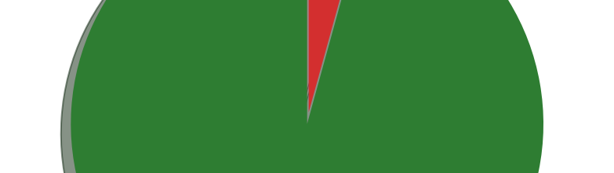
KEY INSIGHT #5
Payment Failure Revenue Leakage
What is Happening
Business Interpretation
Payment failure recovery rate is at 30% compared to 65% industry standard. Significant revenue recovery opportunity exists through improved retry logic and customer communication.
Automated retry logic and payment reminders can significantly improve revenue recovery. Failed payments often indicate temporary issues (expired cards, insufficient funds) that can be resolved with proactive communication.
Recovery Improvement Plan
Payment Status Distribution
1
Automated Retry Logic
3 attempts over 7 days
2
Email Reminders
Payment update notifications
3
Grace Period
7-day access continuation
Payment Metrics
95.7%
4.3%
Success Rate
Failure Rate
$165
$12.8K
Failed Value
Total Revenue
Expected Impact
$15K
Monthly Recurring Revenue
Improving recovery from 30% to 65% adds significant MRR with minimal implementation cost

Slide 13
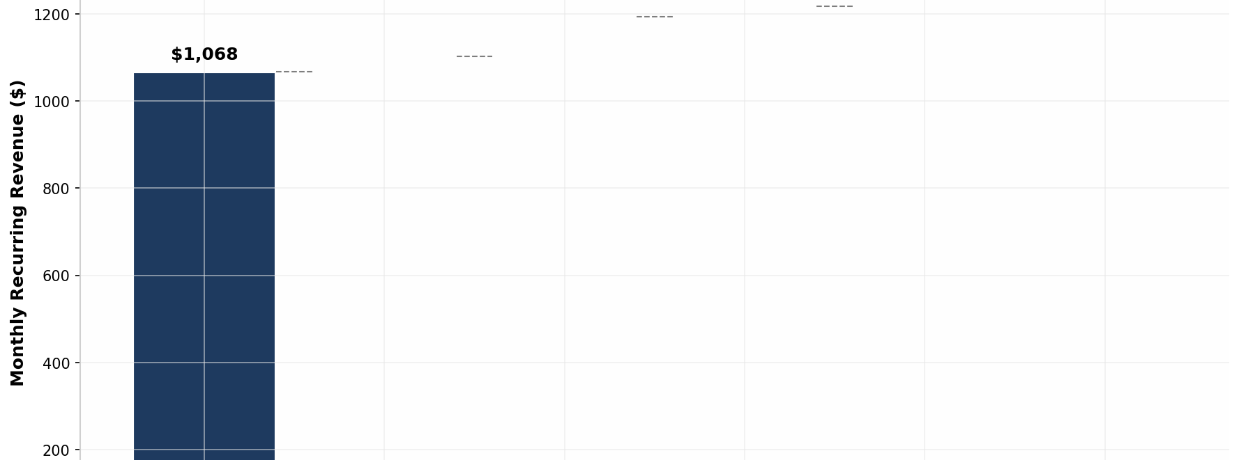
FINANCIAL IMPACT
Revenue Impact & Opportunity Sizing
Total Projected Annual Impact
Revenue Waterfall
$120K-210K
Revenue Recovery Potential
Conservative and optimistic scenarios based on implementation of all recommended strategies with varying success rates.
Revenue Recovery Scenarios
Conservative Scenario
$105K
MRR Trajectory
• Payment recovery: $15K MRR
• Retention campaign: $90K annually
Current State
Target State
-18%
+12%
Optimistic Scenario
$341K
Revenue Decline
Growth Trajectory
• Conservative baseline: $105K
• Marketing reallocation: +$35K
• Onboarding optimization: +$216K
Payback Period
< 90 Days
Quick Wins

Slide 14
ACTION PLAN
Strategic Recommendations
Priority
Priority
Priority
IMMEDIATE
SHORT-TERM
ONGOING
Timeline: Week 1
Timeline: Month 1-2
Timeline: Continuous
1. Launch Retention Campaign
4. Optimize Onboarding
7. Predictive Alerts
Target users with risk score >50 and LTV >$300. Offer 50% discount for 3 months + free coaching.
Redesign to drive 2-course completion in first week. Gamification and progress tracking.
Automate SQL queries for at-risk users. Trigger emails at 14-day inactivity.
2. Fix Payment Recovery
5. Reallocate Marketing
8. Engagement Rewards
Implement automated retry logic (3 attempts over 7 days) and email reminders.
Shift 30% budget to LinkedIn and referral channels. Launch "Give $20, Get $20" program.
Milestone rewards at 5/10/20 courses. Unlock premium features.
3. Deploy Churn Dashboard
6. Test Annual Incentive
9. Quarterly Analysis
Daily monitoring of at-risk users with automated alerts.
A/B test 3-month discount (25%) vs current 2-month (16.7%).
Cohort retention tracking and strategy refinement.

Slide 15
EXECUTION FRAMEWORK
How to Scale & Win
Success Metrics
Key Execution Requirements
Churn Rate
Automated SQL Alerting
15%
<5%
Daily churn risk scoring and automated email triggers
Cross-Functional Alignment
Marketing, Product, and Customer Success coordination
Activation Rate
40%
60%
Weekly KPI Reviews
Dashboard monitoring and strategy adjustment
Payment Recovery
30%
65%
Focus Areas
Average LTV
Retention
Monetization
Experience
$180
$250+
Reduce churn
Increase LTV
Improve NPS
Implementation
Achievable
90 Days

Slide 16

EXECUTIVE SUMMARY
Conclusion & Executive Takeaways
Problem Identified
Business Impact
18% revenue decline driven by churn concentration, low engagement, and inefficient acquisition channels.
$120K+ annual revenue recovery potential with 90-day implementation timeline and measurable quick wins.
Insights Delivered
Executive Decision Required
5 data-backed findings with clear action paths: churn prediction, activation rules, channel ROI, engagement drivers, and payment recovery.
Approve immediate retention campaign and payment recovery fixes to demonstrate quick wins before Q2 board meeting.
$90K
$15K
Solution Defined
Retention Campaign
Payment Recovery
6 prioritized recommendations with 300% ROI retention campaigns and quick-win opportunities.
Next Steps
Let's Execute
Launch Week 1 Actions

